Slide 1

Flu Tracker
Team Member: Anuujin Tsedenbal, Emawayish Haile, Ivan Huang, Michel Caraco, Peter Hardy

Slide 2
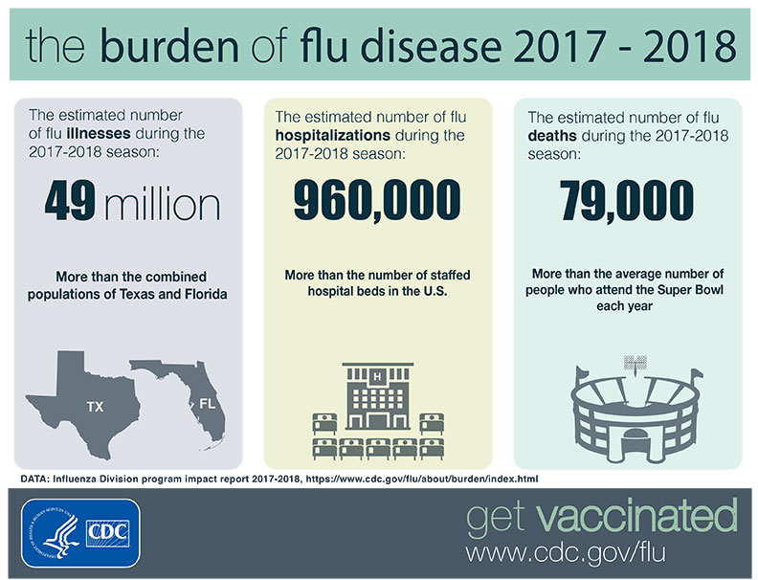
If we can build a model to predict the onset of a flu season by a few weeks, we can help the government, hospitals, and pharmacies strengthen their preventive measures and ultimately save lives.

Slide 3
Machine Learning Model Summary – Keep trying!
Model | R Square Test | R Square Train | Addional Notes
Multi-Linear Regression | 0.932 | 0.949
RandomForest Regression (CDC) | 0.932 | 0.949
RandomForest Regression (AthenaHealth) | 0.81 | 0.9
Support Vector Machine Regression | 0.71 | 0.88
Gradient Boost Regression | 0.85 | 1
K-Nearest Neighbor Regression | 0.69 | 0.70
Deep Neural Network Regression | 0.61 | 1
Ridge Regression | 0.9
Lasso Regression | 0.06
Elastic-Net Regression | -0.021
Principle Component Analysis (PCA) | n/a | n/a | 30 features -> 95% of the data

Slide 4
Web Portal

Slide 5

BACKUP SLIDES

Slide 6
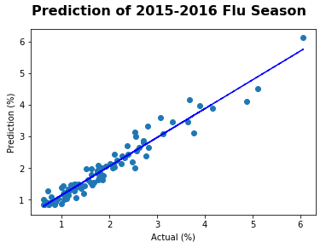
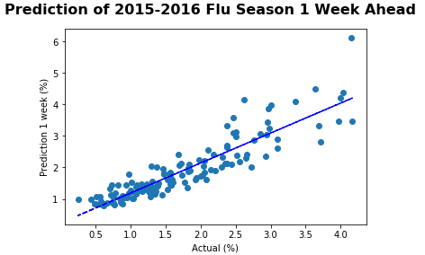
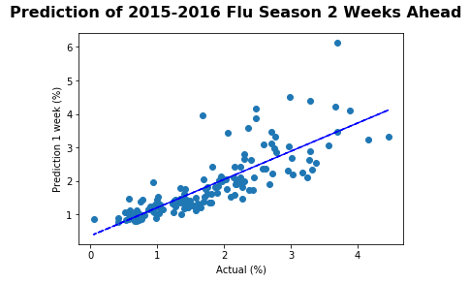



Multi-Linear Regression Model

Slide 7
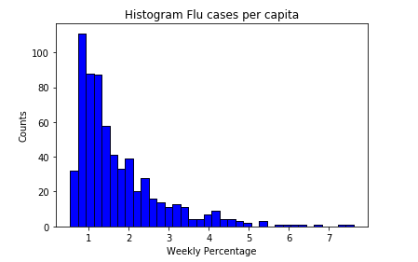
Sample Distribution

Slide 8
Data Source
Google Trend Data set – 129 keywords from 2004 to July 2016
CDC ILI (influenza like illness) report – 2004 to July 2019
AthenaHeath flu related clinic visits
Citation: Yang, Shihao, et al. “Using Electronic Health Records and Internet Search Information for Accurate Influenza Forecasting.” BMC Infectious Diseases, vol. 17, no. 1, 2017, doi:10.1186/s12879-017-2424-7.
Data Source: https://dataverse.harvard.edu/dataset.xhtml?persistentId=doi:10.7910/DVN/ZJZM4F

